Slide 1
Video Analytics at Scale
Junchen Jiang

Slide 2
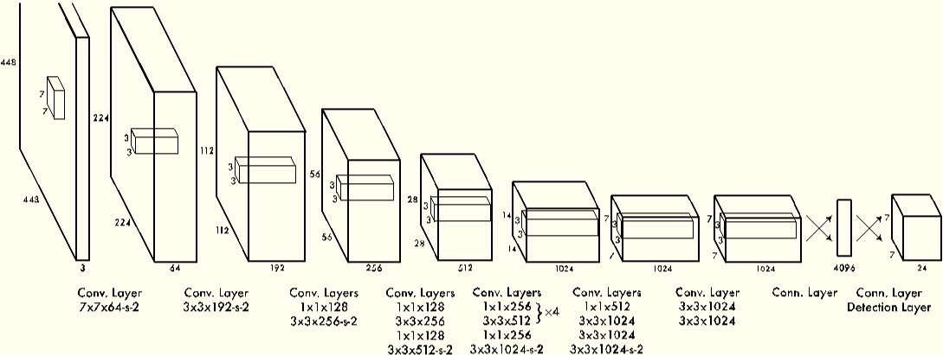
Automated video analytics is everywhere
Deep Neural Networks

Slide 3
Accuracy is rising at the expense of higher cost
Deep Neural Networks

Slide 4
DNN + Video can be prohibitively expensive at scale

Slide 5
Processing one live feed can be costly
GPU: $9,999.99
(or $848.16/mo Azure)
One camera of 30 fps
Network
Storage

Slide 6
Hard to keep up with the increasing cost
What if we have 1000x more cameras?
New York City has 4,176 cameras below 14th Street…
What if videos are 3840 × 2160 (4K)?
Most cameras today are only 1280 x 720
What if DNN + video streaming/conferencing?
Video streaming is 78% of today’s Internet traffic!

Slide 7
Cost of big data analytics might be dominated by video analytics
GPU
Network
Cost
Data analytics
Video analytics
Storage
2012
2017

Slide 8
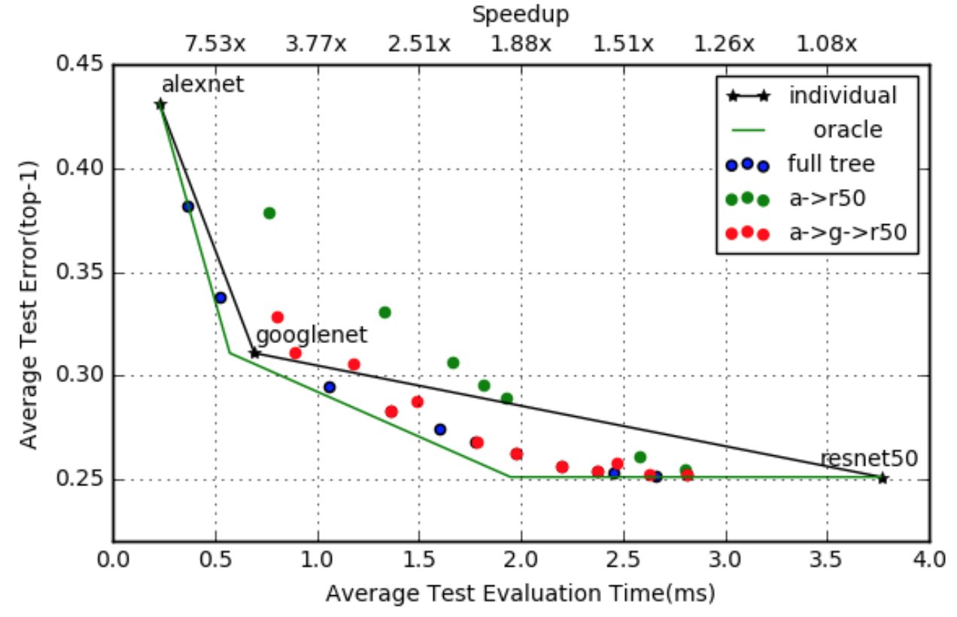
How about cheaper NN architectures?
E.g., Early exit, compress CNN models to fewer layers, etc
Achieved performance
Still room for improvement, though not substantial
Better
Optimal outcome of combining conventional networks
Bolukbasi, et al. Adaptive Neural Networks for Efficient Inference. ICML 2017

Slide 9
How to achieve lower cost and higher accuracy?
A promising alternative:
Picking optimal “configurations”

Slide 10
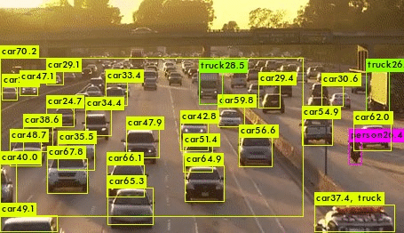
No need to sample all frames
Frame sampling
Mean Avg Precision (%)
Sweet spot: Near-optimal by looking at only 10% frames, i.e., 10x speedup
Better
Slow moving objects:
Low frame sampling rate
Frame sampling rate (%)

Slide 11

No one-size-fit-all value
Slow moving objects
Low frame rate
Slow moving objects
Fast moving objects
Mean Avg Precision (%)
Better
Fast moving objects
High frame rate
Frame sampling rate (%)

Slide 12
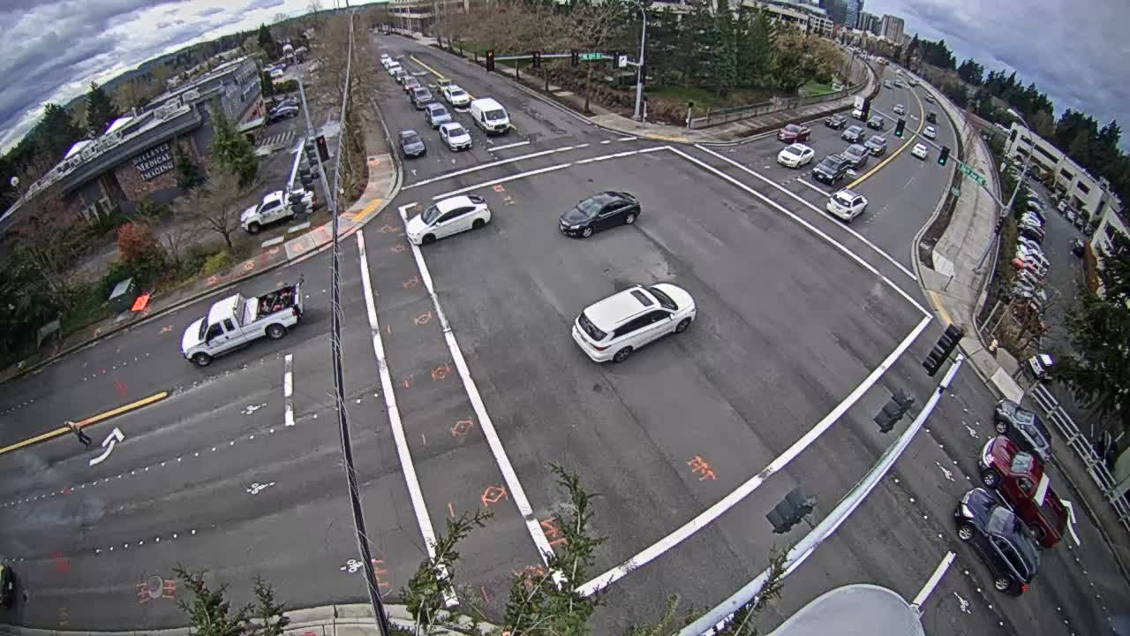
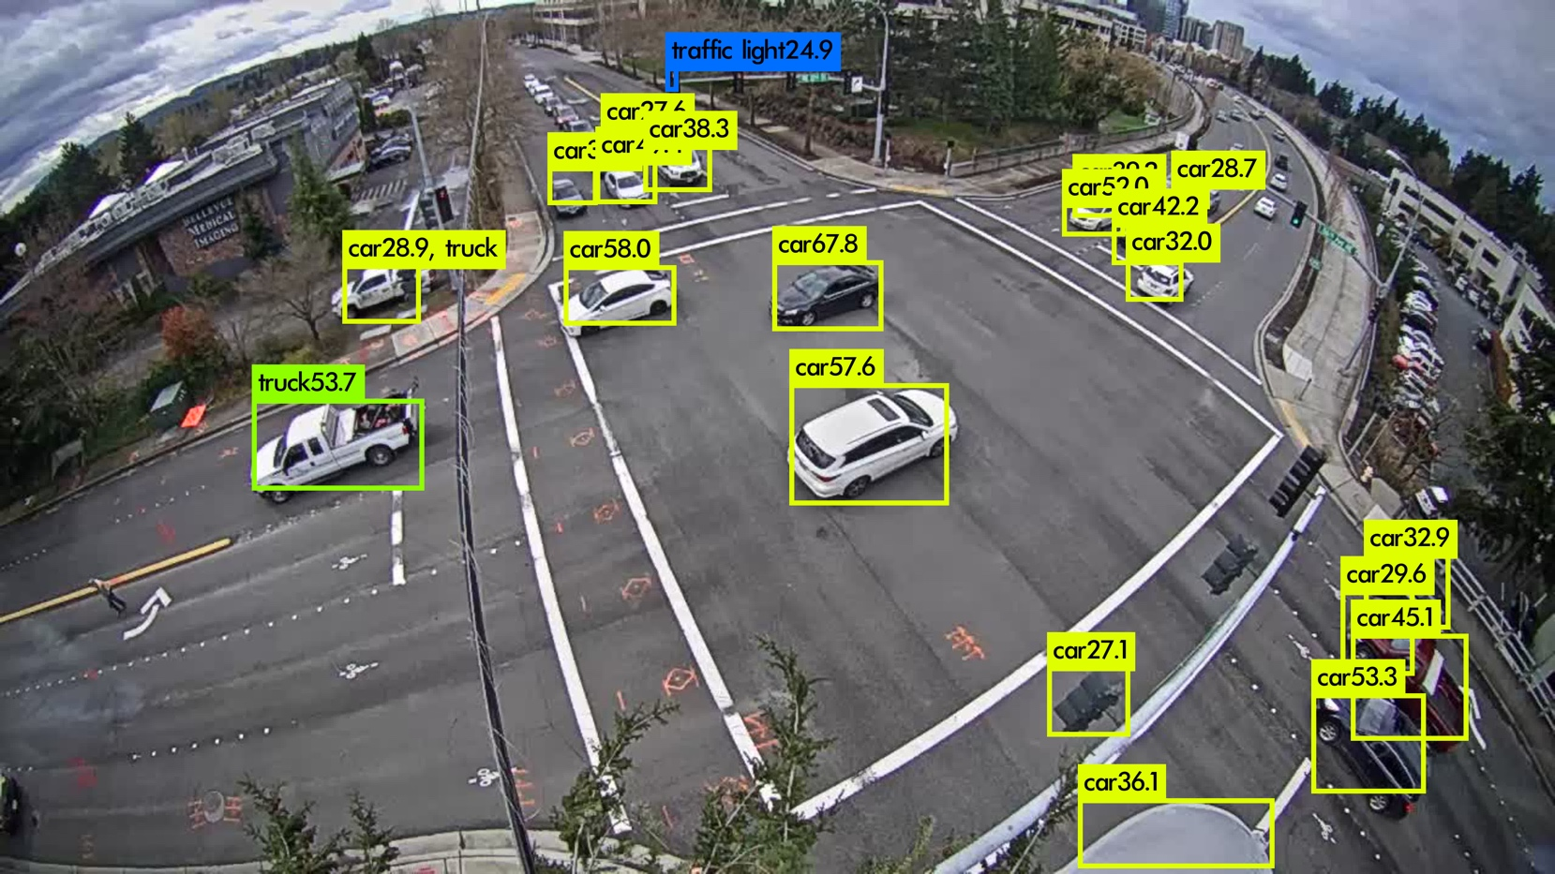
Input resolution affects the speed-accuracy tradeoff too
Resized to
input resolution
Low resolution can’t detect small objects
Faster but more false negative
Higher resolution:
Slower but detects more objects

Slide 13
Input resolution affects the speed-accuracy tradeoff too
High input resolution
Sweet spot: Near-optimal w/ 3x speedup
Mean Avg Precision (%)
Low input resolution
Better
Processing time (ms)

Slide 14
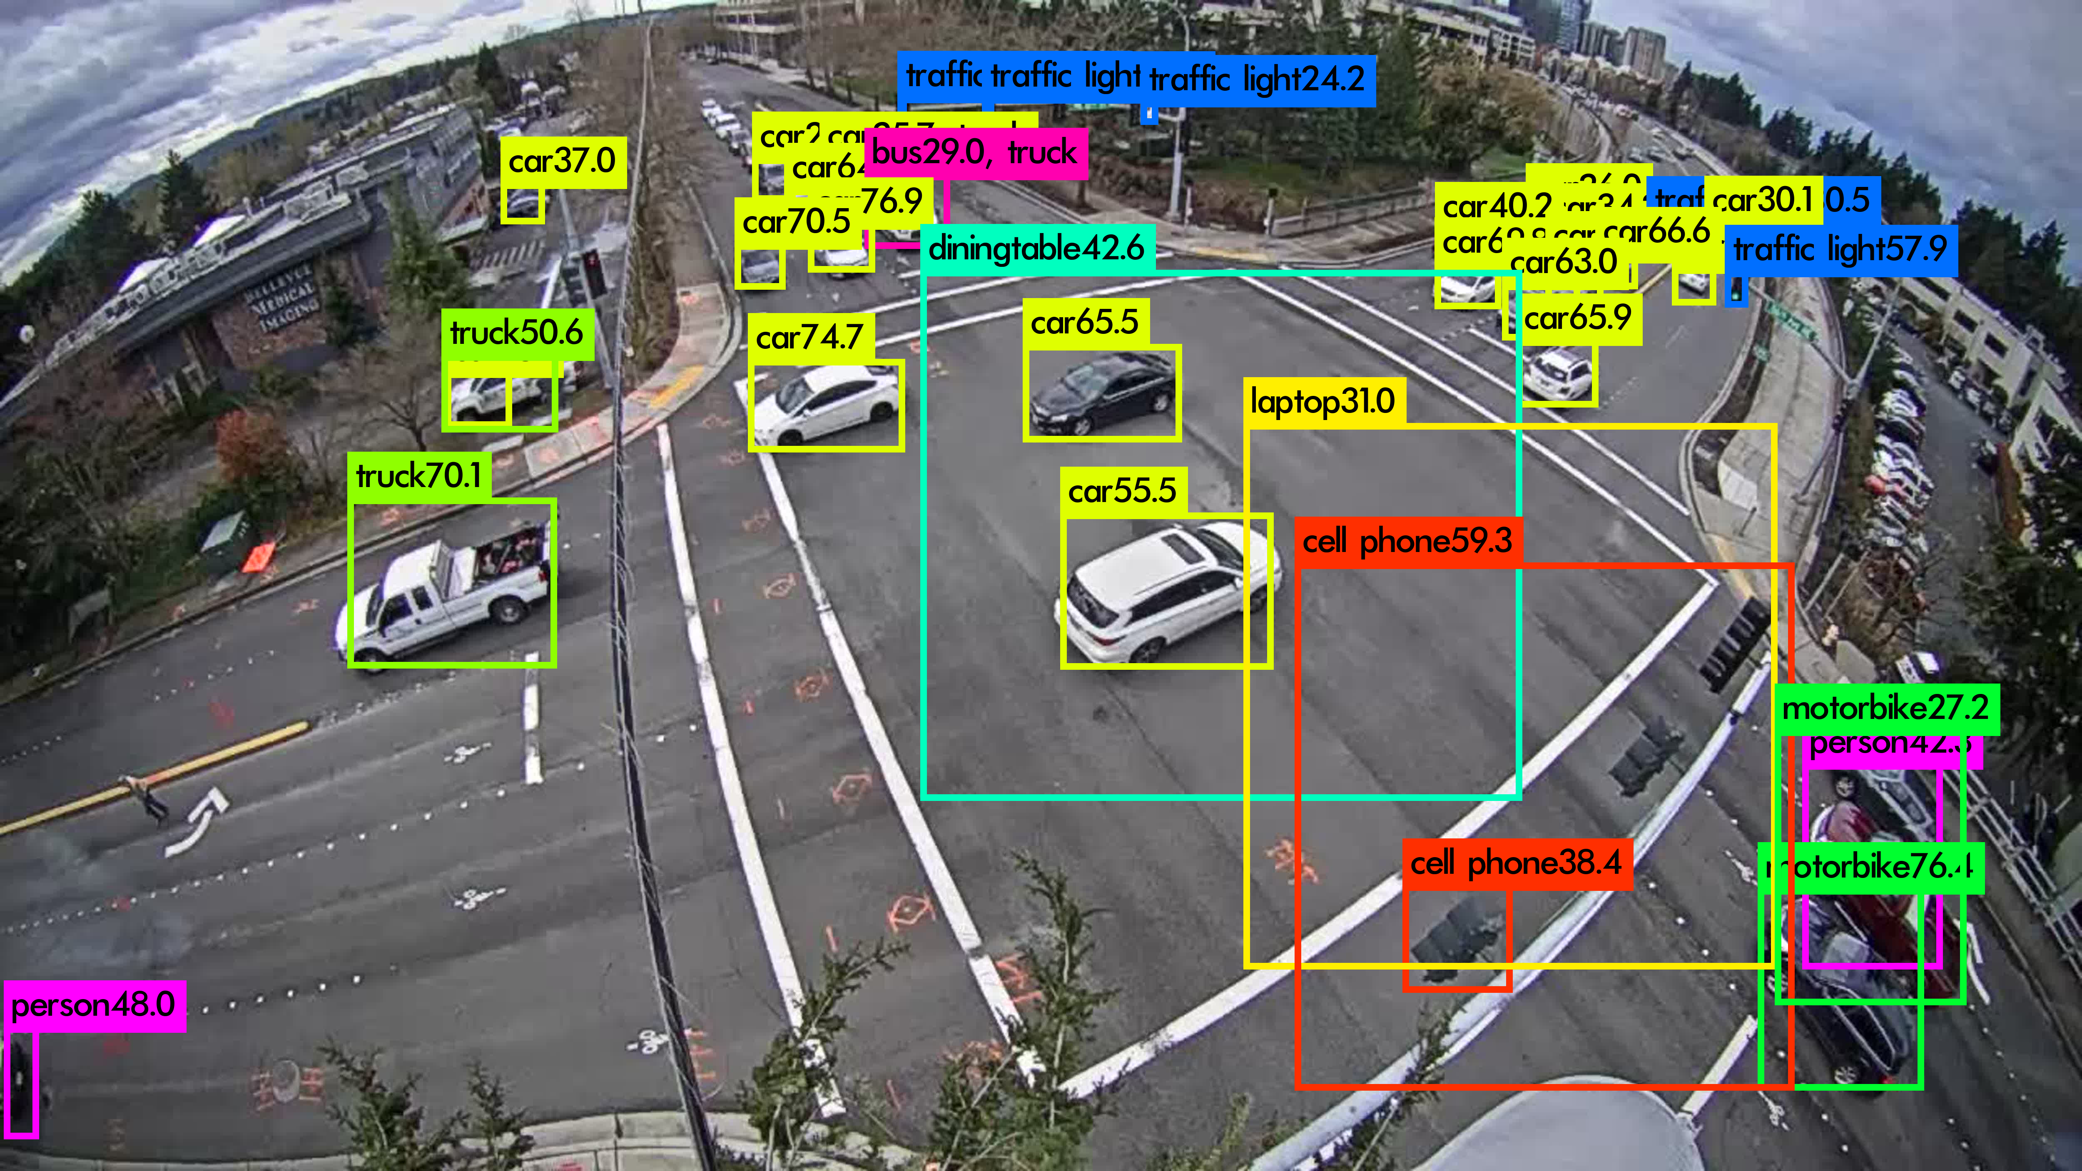
Again, no one-size-fit-all value
Camera A
Camera B
Mean Avg Precision (%)
Too high resolution leads to high false positive
Processing time (ms)

Slide 15
Other configurations can have similar effect
Frame sampling rate
Input video resolution
Video brightness
Confidence threshold
Max # of region proposals
Pre-trained CNN models
..
Prior work picks these configurations offline!

Slide 16
How to pick optimal configurations systematically and adaptively?

Slide 17
The framework
Q3: How to formulate the adaptation process?
Q2: How to get feedback w/o knowing the ground truth?
Q1: How to explore large config spaces efficiently?
Configuration Controller
Configurations
Frame sampling
{1, 5, 30, …} fps
Input resolution
{198, 448, 960, …}
…

Slide 18
Q1: How to handle large configuration spaces?
Opportunity: Spatial & temporal correlation
E.g., multiple cameras (#1, #3) share the same optimal configuration
Mean Avg Precision (%)
Frame sampling rate (%)
Idea: Let similar cameras explore the config space together

Slide 19
Q2: How to get the feedback w/o ground truth?
Confidence
Car #1: 67%
Car #2: 40%
Truck: 55%
…
Configuration Controller
Mean Avg. Precision
(Ground Truth)
F(Avg_Confidence)
Idea: Can we guess accuracy based on confidence?
Or maybe crowdsourcing in real-time?

Slide 20
Q3: How to formulate the adaptation process?
Multi-armed bandit?
Learn best config by cameras
Handle noisy feedback signal
Configurations are not independent
Bayesian optimization?
Configuration Controller
Decision Service?
…
Configurations
Frame sampling
{1, 5, 30, …} fps
Input resolution
{198, 448, 960, …}

Slide 21
Summary
Applying DNN on videos can be prohibitively expensive at scale
Picking optimal configurations can strike a resource-accuracy balance
It’s challenging to dynamically identify optimal configurations
Large configuration spaces
Hard to get ground truth-based feedback
How to do it systematically
Notes:
john: adding feed in multiple frames at the same time
upper bound
neural networks

